Slide 1
The cell biology lab 6
Cell fractionation

Slide 2
Cellfractionation
Each organelle has characteristics (size, shape and density) which make it different from other. If the cell is broken in a gentle manner, each of its organelles can be isolated by a process called ( cell fractionation ).

Slide 3
Cell fractionation: is the process of producing pure fractions of cell components. The method of cell fractionation chooses depends on the tissue, the cell type and the particular cell of
The process involves two basic steps:
1- Disruption of the tissue and lysis of the cells.
2- Centrifugation.

Slide 4
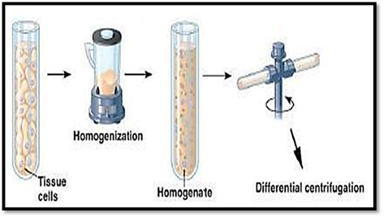

Slide 5
1- Tissue disruption and cell lysis involve:
1- Homogenization: involves the use of a mechanical homogenizer, like a blender and mortar or pestle, to break the tissue apart and lyses the cells.
2- Sonication: involves the use of ultrasound to disrupt the cells.
3- Osmotic lysis: is dealing with cells that are vulnerable to osmotic
4- Detergents: to make holes in the plasma membrane.
5- High pressure: used to force cells through a small hole.

Slide 6
2- Centrifugation: separates cell components based on size and density. There is two types of centrifugation: a- Differential centrifugation: based on differentiation in size and weight of cell components. b.Density gradient centrifugation: based on density of cell components.
The separation of the cellular components is based solely on their sedimentation rate.
The sediment to form a pellet at the bottom of the tube, while smaller, less dense components remain in the above portion (supernatant).

Slide 7
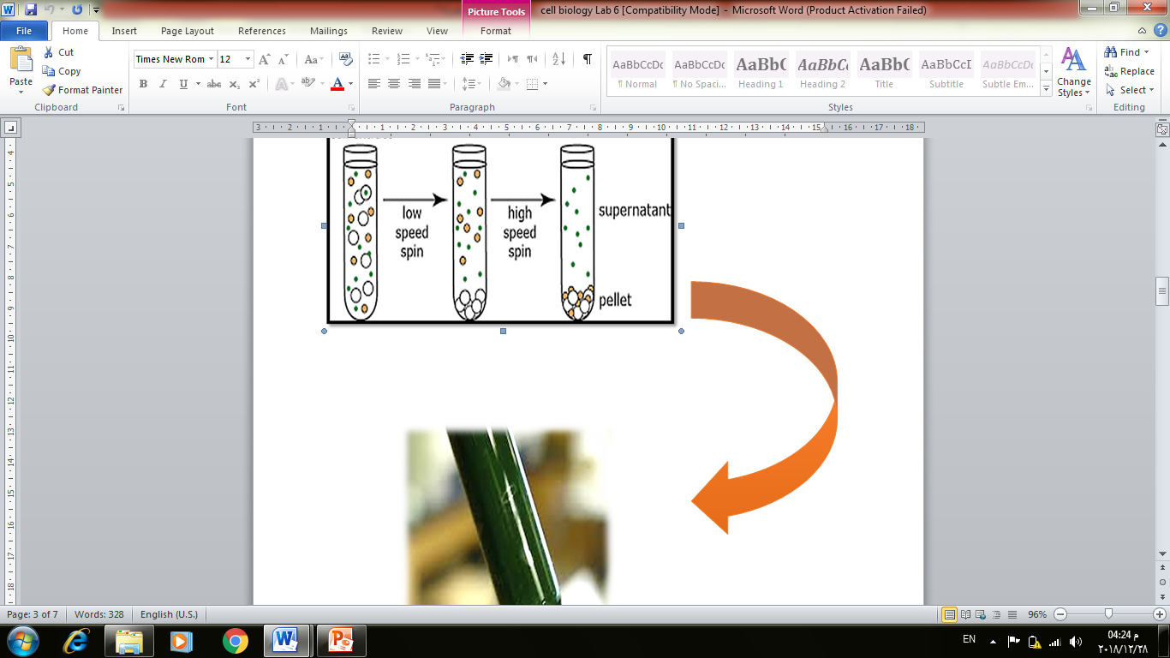

Slide 8
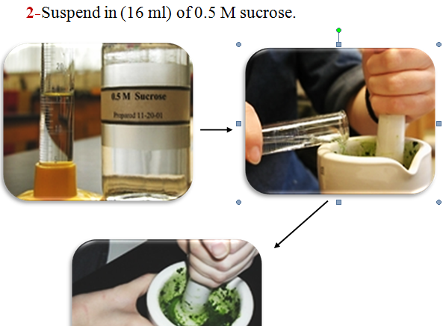
Isolation of chloroplasts by differential centrifugation
1- Prepare, weigh (8 gm) and homogenize with ½ tsp clean sharp
2-Suspend in (16 ml) of 0.5 M sucrose.sand in mortar and pestle to a paste.

Slide 9
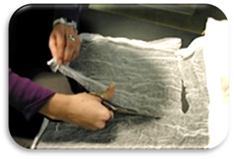
3- Filter: homogenate through about eight layers of clean cheesecloth in a glass funnel and record volume .

Slide 10
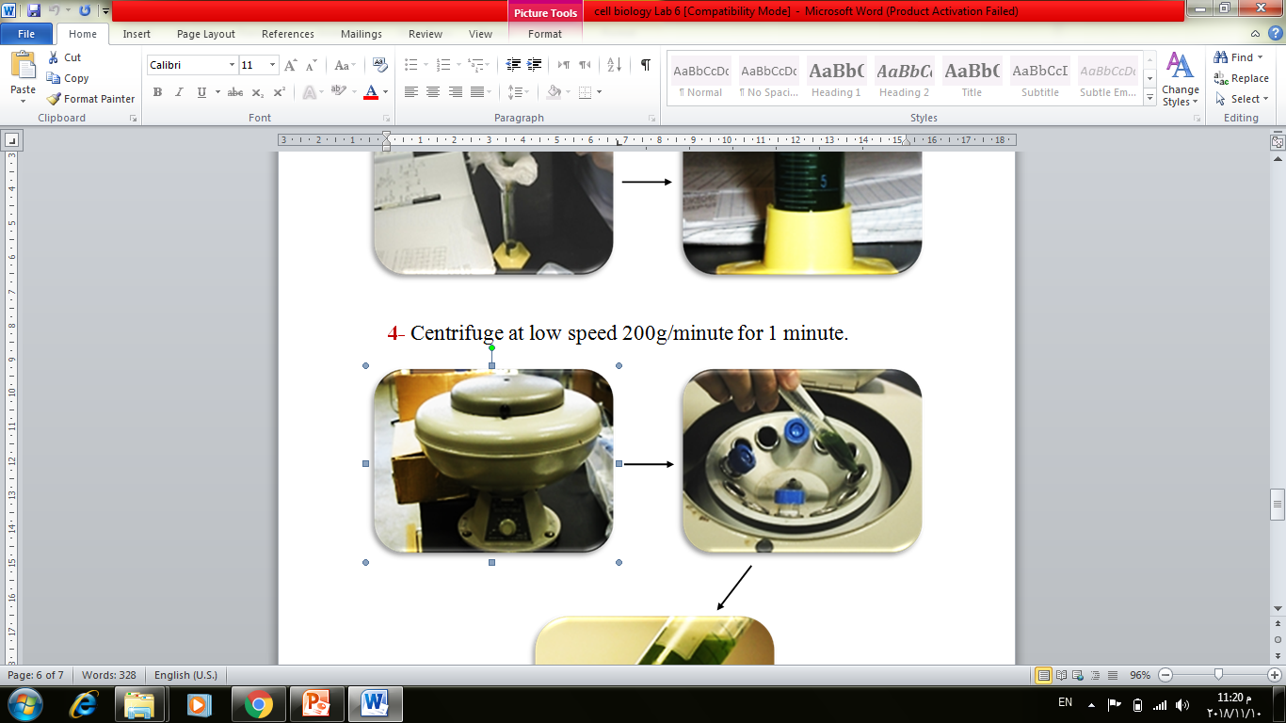
4- Centrifuge at low speed 200g/minute for 1 minute

Slide 11
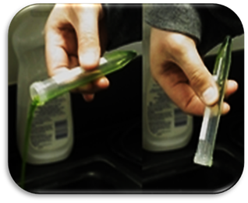
5- Discard supernatant and resuspended the pellet in 10ml of .sucrose

Slide 12
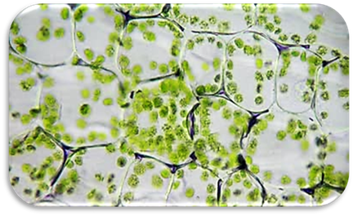
6 - Examine suspended organelles under microscope 10x, 40x and 100x.

